Slide 1

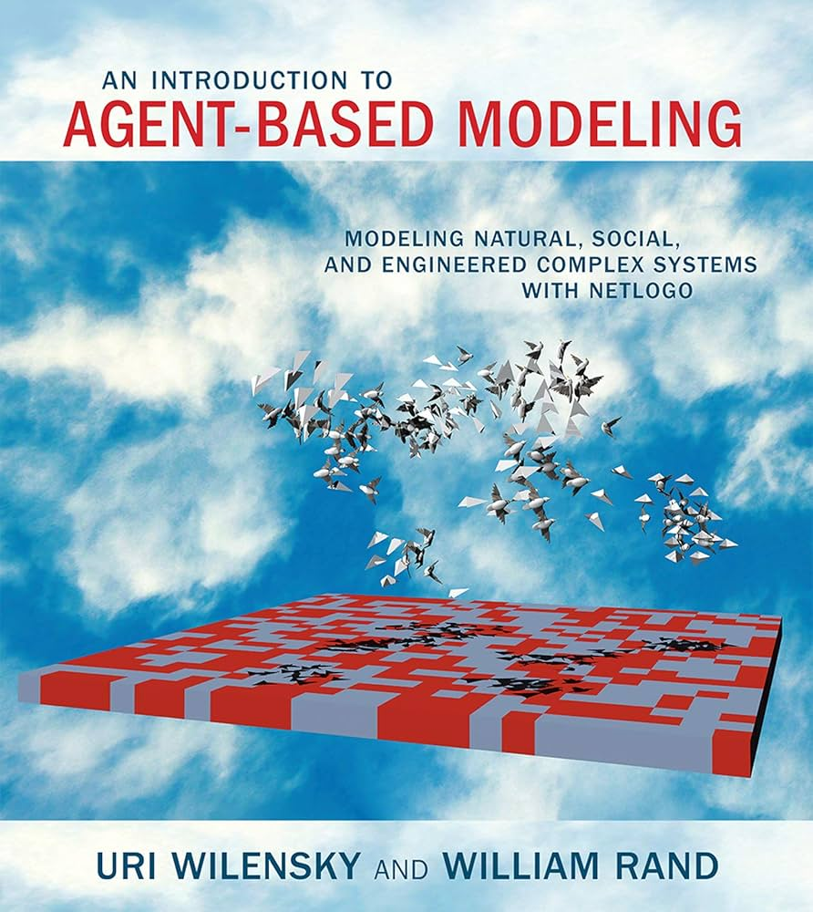
NetLogo
Uri Wilensky
NetLogo is a programming language made for building and running agent-based models
It is pack with example model, perfect for learning !
https://www.netlogoweb.org

Slide 2
Table of content
For all the models, start them, let them run, think about them, then read the model info and do what’s proposed in the Things to try section. If you feel adventurous, try the Extending the model section as well ! (bold = more important for learning)
Model | What to learn
Sheep wolf predation | Emergence and
Ants | Emergence
Flocking | Micro rules -> macro-patterns
HIV | Network and epidemic dynamics
Mammoths | Model of human expansion !
Segregation | Population change from individual preferences
Fire | Threshold effect

